Slide 1

Case Study
      Regrow Hair Clinic

Slide 2


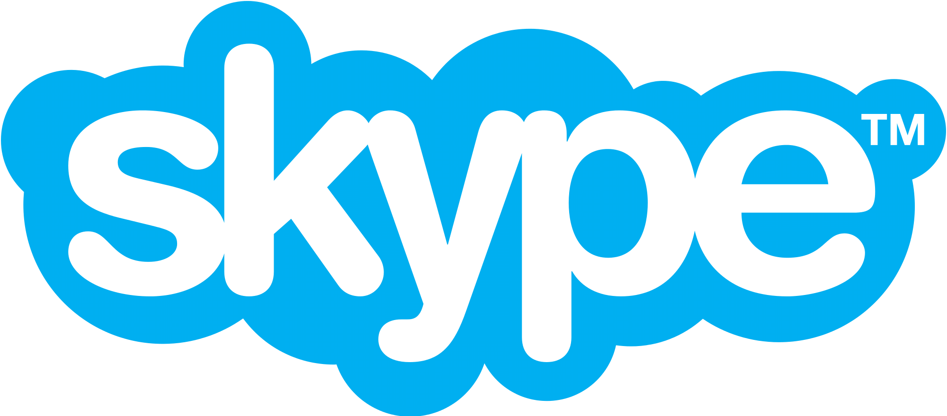
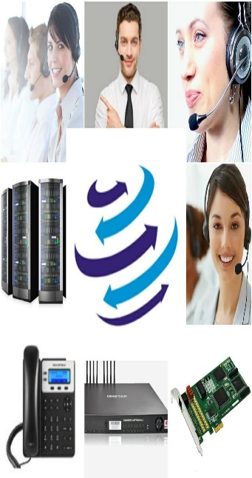



+91-856-00-00-600
www.dialerindia.com
avyuktaindia
CRM Based Dialer - IVR - Cloud Telephony
PRI Card - GSM Gateway - Servers - Headsets
(FXS/FXO/IP Phone// Press 1/ IP PBX)
Auto / Predictive / Hosted – WFH - PC Less – Android - Cloud Dialer
DoT Approved A / A+ Grade VoIP with/out Dialer Combo
Web / Software Development/e-Com / Custom Asterisk Solutions
+1-408-791-3820
+91-856-00-00-600
sales@dialerindia.com

Slide 3

Regrow Hair Clinic Case Study
About Regrow Hair Clinic
Regrow Hair Clinic The Global Leaders in Hair Transplant Since 2015. Regrow Hari Clinic is one of the best natural hairline creation in hair transplant located at Haridwar, Uttarakhand . Most innovative cases in transplant are being done by Regrow Hair Clinic in hair transplantation these days. To date, Regrow Hair Clinic have transplanted over 6 million hair grafts from scalp to scalp, beard to beard and beard to scalp and scalp to beard, and also performed body hair transplant in some cases.

Slide 4
Regrow Hair Clinic Case Study
Services Offered by Regrow Hair Clinic
• Quick Hair Transplant
• Hair Transplant Cost
• Beard Hair Transplant
• Female Hair Transplant
• FUE Hair Transplant
• Hair Transplantation for Men
• Eyebrow Hair Transplant
• Body Hair Transplant
• Eyelash Hair Transplant
• Best PRP Treatment
• Mesotherapy Treatment
• Dense Hair Implantation

Slide 5
Regrow Hair Clinic Case Study
Unique Hair Transplant Methods at Regrow Clinic
Regrow Clinic offers swift hair transplant procedure known as the QUICK FUE Hair Transplant®. The hair transplant doctor uses a SAVA Implanter, a special tool to complete the procedure in four hours. Main Techniques and Procedures are listed as follows:
1 . Quick FUE Hair Transplant
2. Dense Hair Implantation
3. Follicular Unit Extraction
4. Corrective
5. Female Hair Transplant
6. Male Hair Transplant

Slide 6
Regrow Hair Clinic Case Study
Regrow Hair Clinic Requirements
Regrow Hair Clinic needed a system with third party solution to accumulate all the information on a single platform. They wanted a solution which can manage their Schedules, Client Database management, All Logs and recordings under single platform as before our solution they were managing such things like Client Meetings scheduling, Call-back Management, New Clients Management manually on multiple platforms which was tedious and too much time taking and even after a lot of hard work their records were still scattered on multiple channels .

Slide 7
Regrow Hair Clinic Case Study
Challenges at Regrow Hair Clinic
1. In Early stages we need to fetch the relevant data from their database which were
scattered on multiple channels, with different condition.
2. To manage such information a Special applications needs to created where all
Information can be available under a single roof.
3. Another big challenge was to maintain the privacy and security of data as Security of
data is a major issue with all the clients.
4. Clicl2Call APIs implementation with Newly created System and Avyukta Dialer Solution
to overcome the challenge of data privacy with security.
5. Flawless Multi tree IVR with Follow me routing and After hours routing flexibility.

Slide 8
Regrow Hair Clinic Case Study
Solutions we implemented at Regrow Hair Clinic
1. We created a Customised Dedicated MIS System with Lead Management to maintain
all there Data under single roof.
2. Multiple APIs are implemented so that real time data sync can be done between MIS
System and Avyukta Dialer suite.
3. Few clicks call records in MIS system and availability for anytime log availability for
auditing purpose.
4. Click2 Call integration on MIS System for initiate calls directly from MIS System only,
without login on dialer.
5. Multi tree IVR with After Office hours call routing with flexibility.
6. Follow me call routing with After hours call routing flexibility.

Slide 9
Regrow Hair Clinic Case Study
The Result
1. Our Dedicated MIS System helped the client to manage their clients data under single roof .
Which reduced manual hard work to maintain the customer data within minimal time which
improved the overall productivity of work force drastically.
2. Our Specially designed MIS reporting system provided them proper reports for all satisfied and
unsatisfied customers which helps them to improve the week sections of their services
depending upon the reports and feedbacks from customers.
3. With Our Solution now call routing can be swiftly managed according to any type of
requirement.
4. Flawless IVR, Click2Call and follow me call routing almost minimised the time for the customer
as well as their work force and hence team productivity is overall increased by 60-65 %.

Slide 10



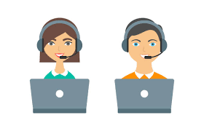
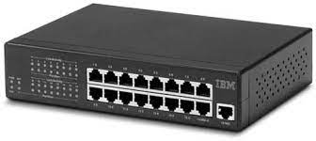
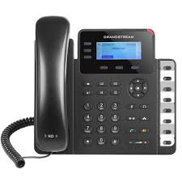

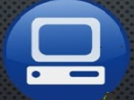
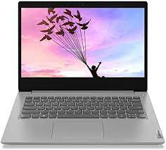
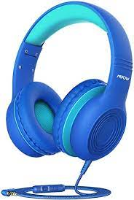
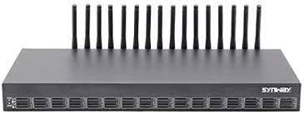
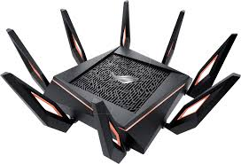

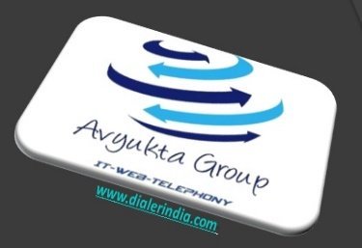
Regrow Hair Clinic Case Study
Regrow Hair Clinic Call Flow
Agent Floor
Inbound Calls From New / Existing Customers
Call Backs /Outbound from PRI
INB and OB Calls
Switch
Avyukta
Dialer
Server
Sales Force
USB Headphone
IP Phone
Soft Phone
Agent PC
Wi-Fi
Router
Admin Quality/Supervisor/TL
25+ Reports
Voice Logs
GSM Gateway
Complete Recordings logs
Campaign Manager

Slide 11
Regrow Hair Clinic Case Study
Regrow Hair Clinic Architecture
GSM Gateway
Agent Floor
To PSTN Network from
GSM from TSP
Internet Only for Support access
Avyukta
Dialer
Server
Switch
Sales Force
USB Headphone
IP Phone
Soft Phone
Agent PC
Wi-Fi
Router
Admin Quality/Supervisor/TL
25+ Reports
Voice Logs
Complete Recordings logs
Campaign Manager

Slide 12
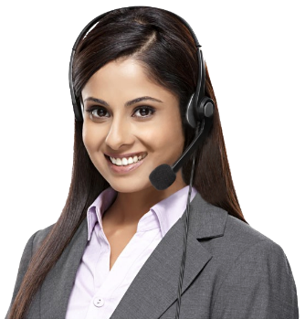


Political Elections / Campaigns
Insurance / Shares / Loan / DSA’s
Taxi Services / BPO / Collections
Restaurant / Hotels / Customer Care
E com / Mobile Apps / Website
Survey / Appointment Setting / Lead generation
Astrology / Universities / Colleges
Recruitment / MIS / Placements / Admissions
24 X 7 X 365 “Decade” of 1900+ Satisfied BPO’s
avyuktaindia
Predictive / Auto Dialer: Current Calls/ Output X 400%
Hosted / Premised / BPO / DoT VoIP / PRI / GSM Gateway
Smart IVR / Cloud Telephony / Omni Channel / CRM / API
OBD / Press 1/ Voice SMS / Masking / OTP / 1800
Survey / Appointment Setting / Lead Generation
Domestic International Call Center / BPO Setup
The Competition Assassinators
275+ Live Ref. Centres
11 Yrs. X Asterisks Dev.
9 Countries,91+ Cities
Live Demo / PoC
Lower than the Lowest Professional Bidder
All possible Techno-commercial models
No Blame Game : Your CTI-CRM-VoIP “SPOC”
100% Gov. Compliance
72 HR Refund Policy
10% Ref. discount/s
24X6 Support NoC
“The” single Answer to your
A to Z
Tel- ”e” - calling requirements
+1-408-791-3820
+91-856-00-00-600
sales@dialerindia.com
Avyukta Intellicall www.dialerindia.com

Slide 13
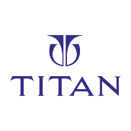

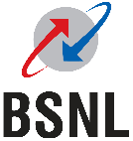


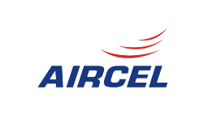
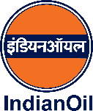
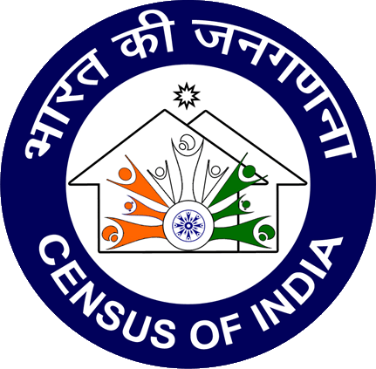
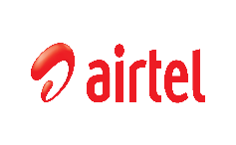

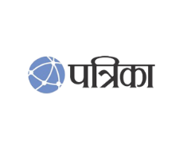




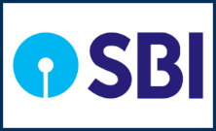
Trust over 11+ years
Some* Major Clients

Slide 14
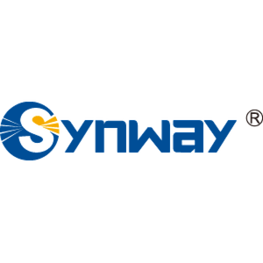
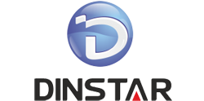
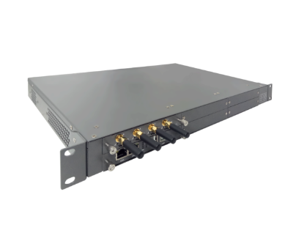

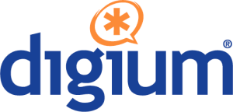
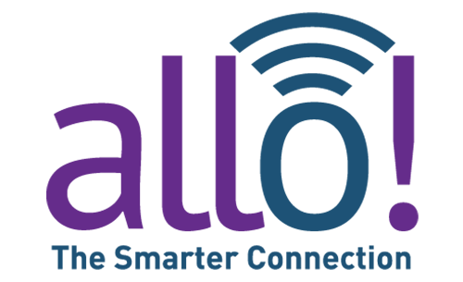
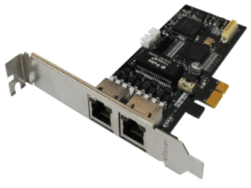
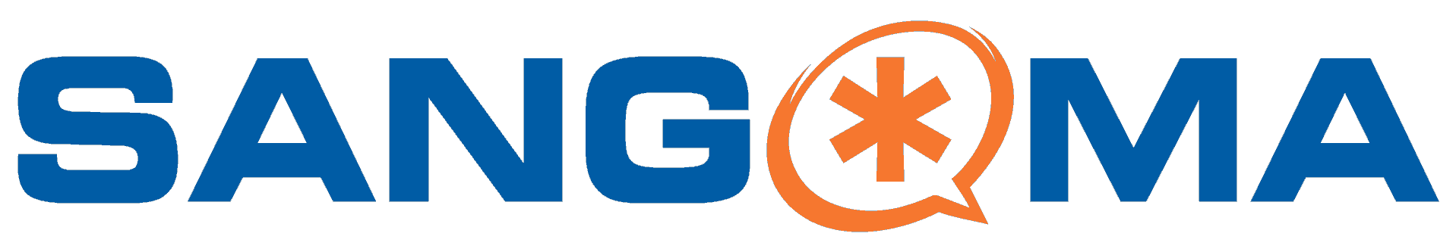

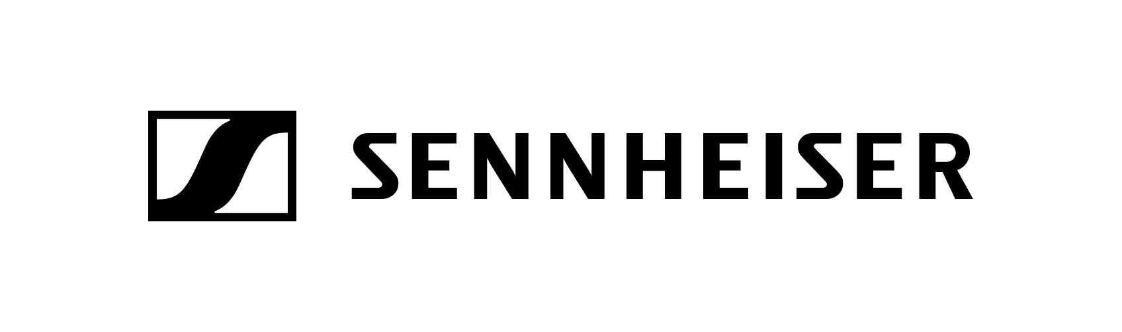
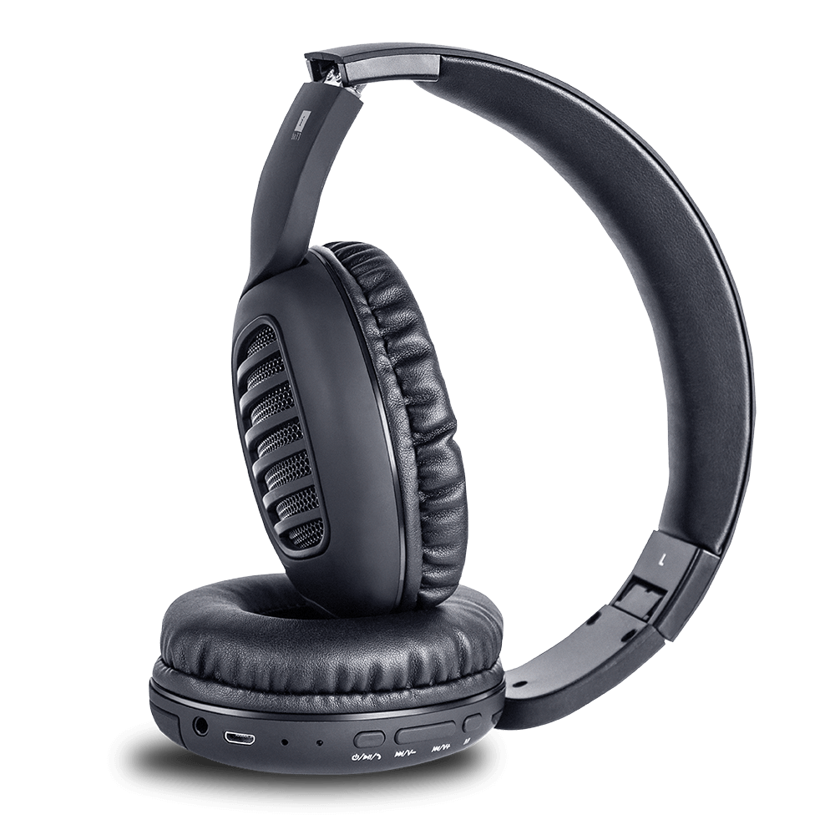



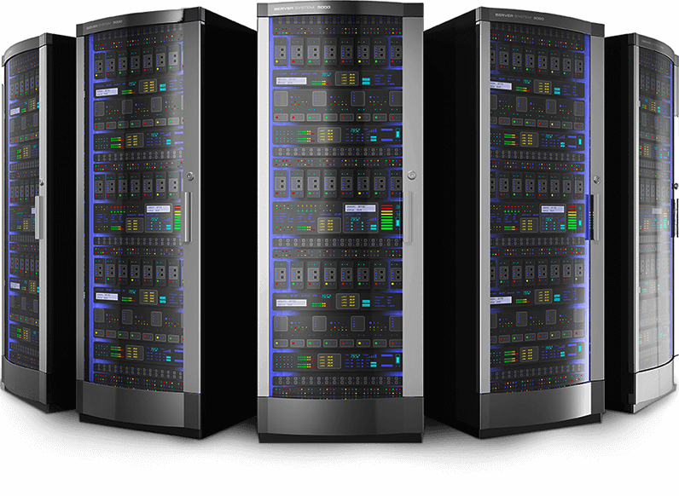
CTI Hardware Partners

Slide 15
Useful links
Domestic Architectures
International Architectures
Demo Video
Video Tutorials
Sample Voice Overs, Jingles and Melodies
DoT License / OSP Registration
PRI card / GSM Gateway / IP Phones / Headphone Buy Online
Vendor Comparison
Avyukta CRM Demo Video
Avyukta Sales CRM Demo Video
Avyukta Task CRM Demo Video
Avyukta Today CRM Demo Video
Request a Demo
Avyukta Client CRM Login
Support SLA
Avyukta on Youtube
Avyukta on Linkedin

Slide 16
Regrow Hair Clinic Case Study
Thank You for Your Time

